Slide 1

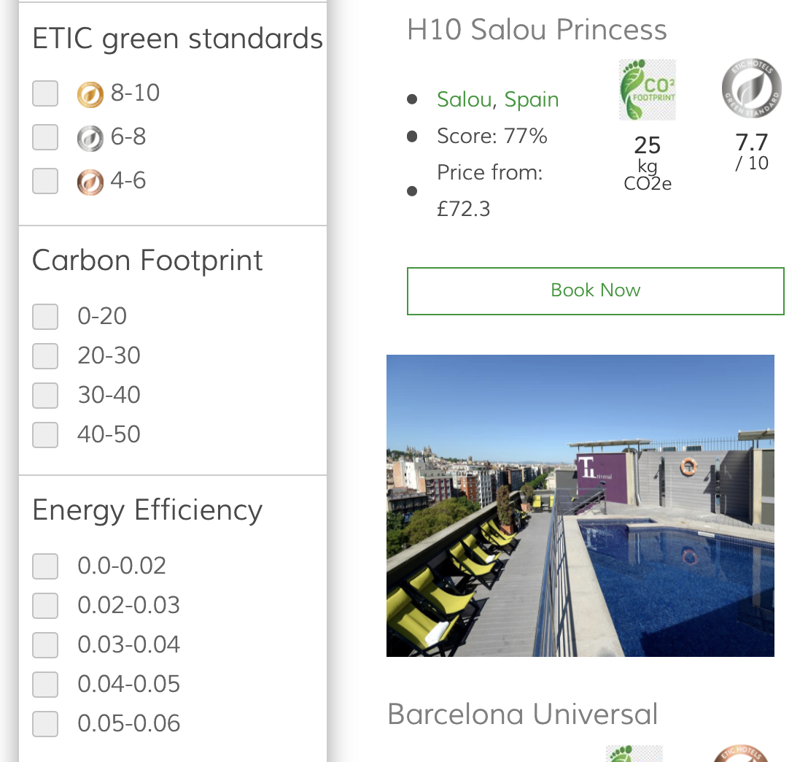

ETIC Green Score (/10)
H10 Salou Princess
• Salou, Spain
• ETIC Score: 7.7
• Reviews: 8.2 (2,218+)
• From: £72.3
25
tCO2e
7.7
/10
Carbon Footprint (tCO2e)
Energy Efficiency
Barcelona Universal

Slide 2
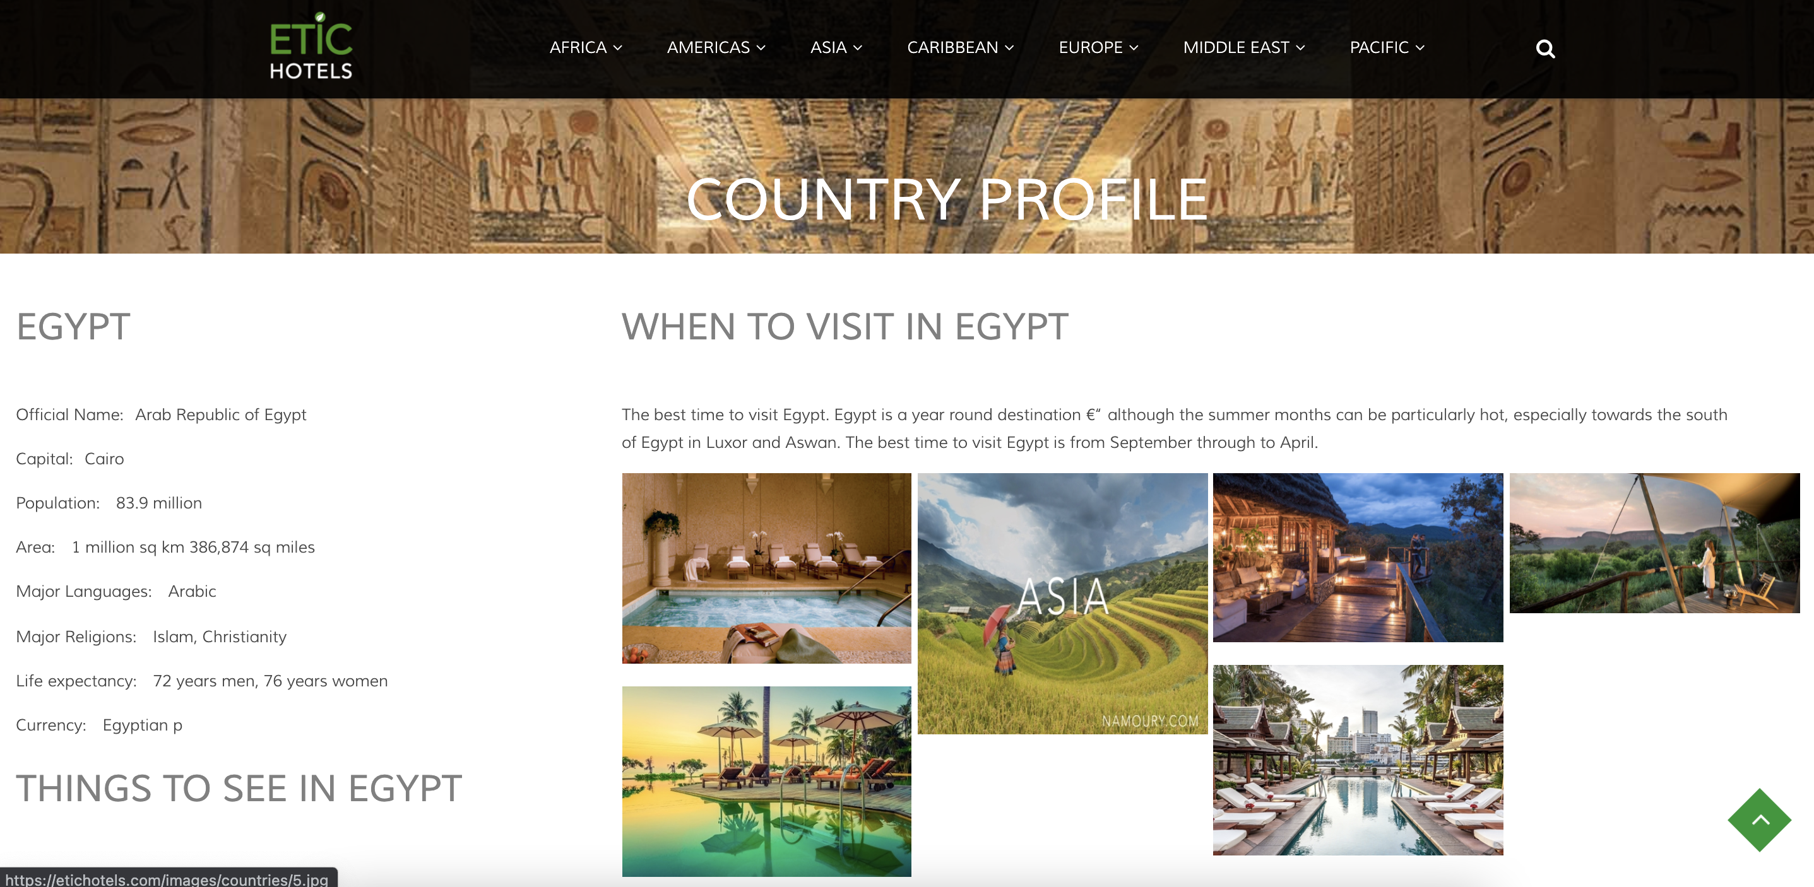
COUNTRY PROFILE doesn’t seem to be centered (I have MacBook Pro 13”)

Slide 3
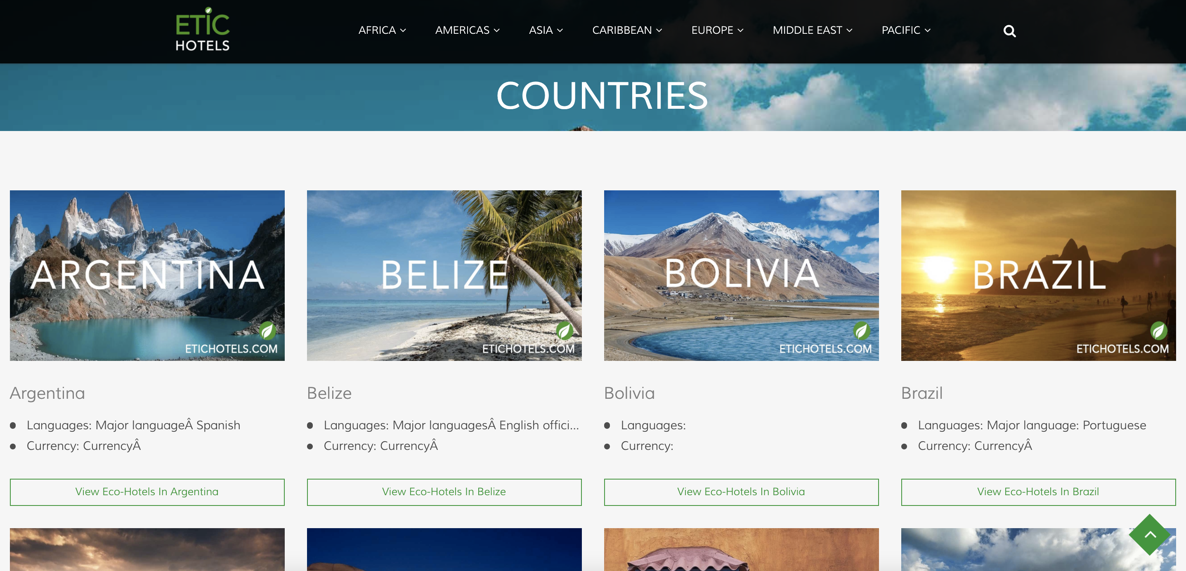
SAME WITH COUNTRIES, IT’S NOT CENTERED IN THE SCREEN (I have MacBook Pro 13”)

Slide 4
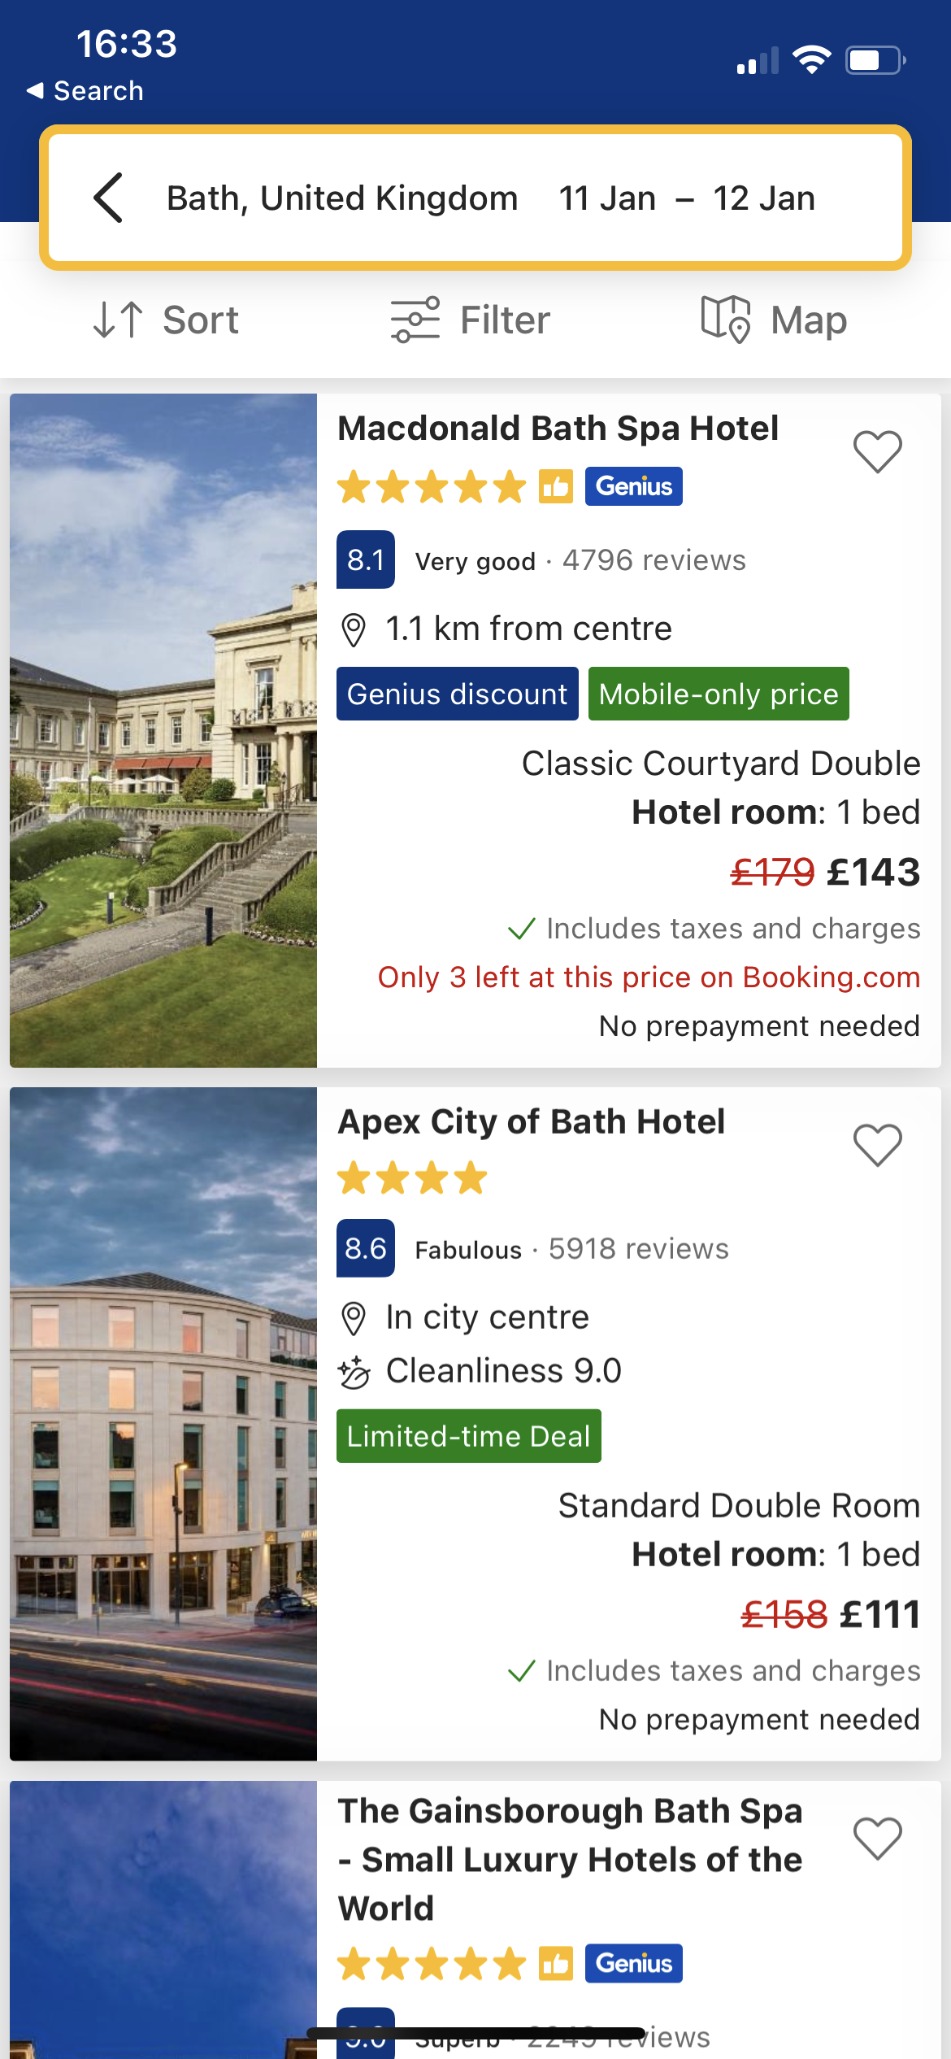
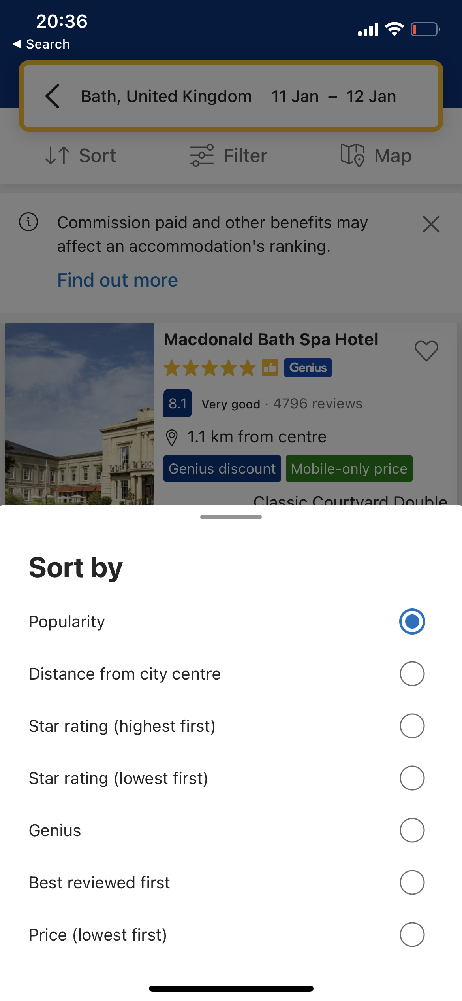
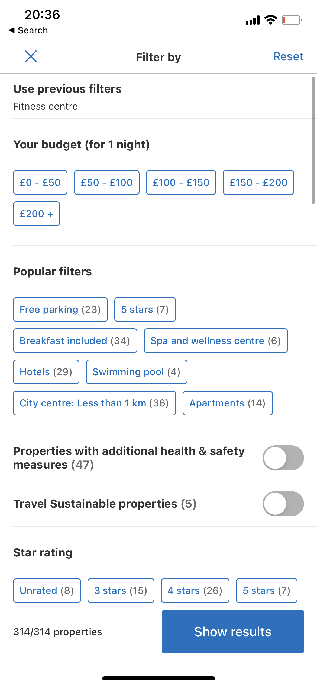
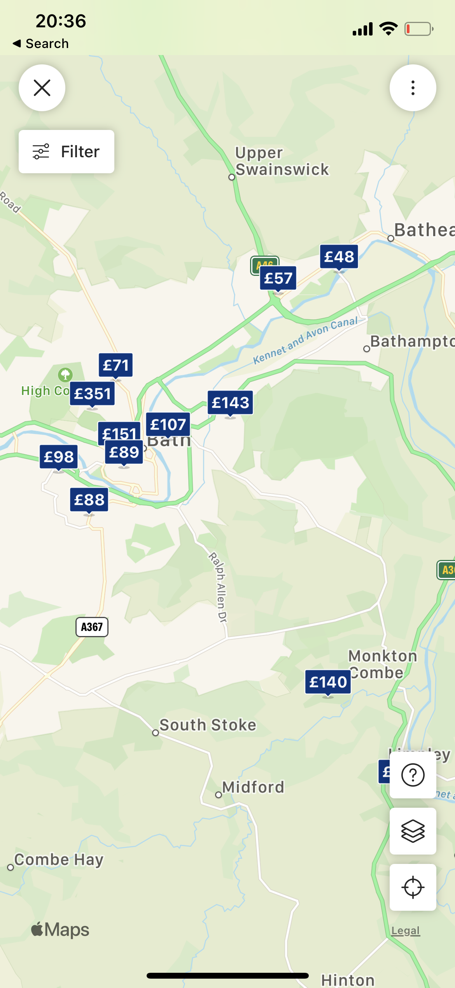

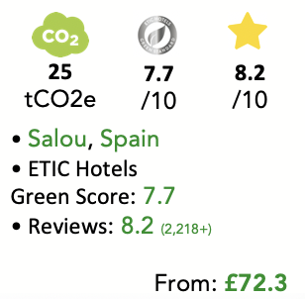
Mobile Version
Please replace the blue by the ETIC green
H10 Salou Princess
25
tCO2e
7.7
/10
8.2
/10
• Salou, Spain
• ETIC Hotels Green Score: 7.7
• Reviews: 8.2 (2,218+)
From: £72.3
Another Hotel
Corinthia Hotel

Slide 5
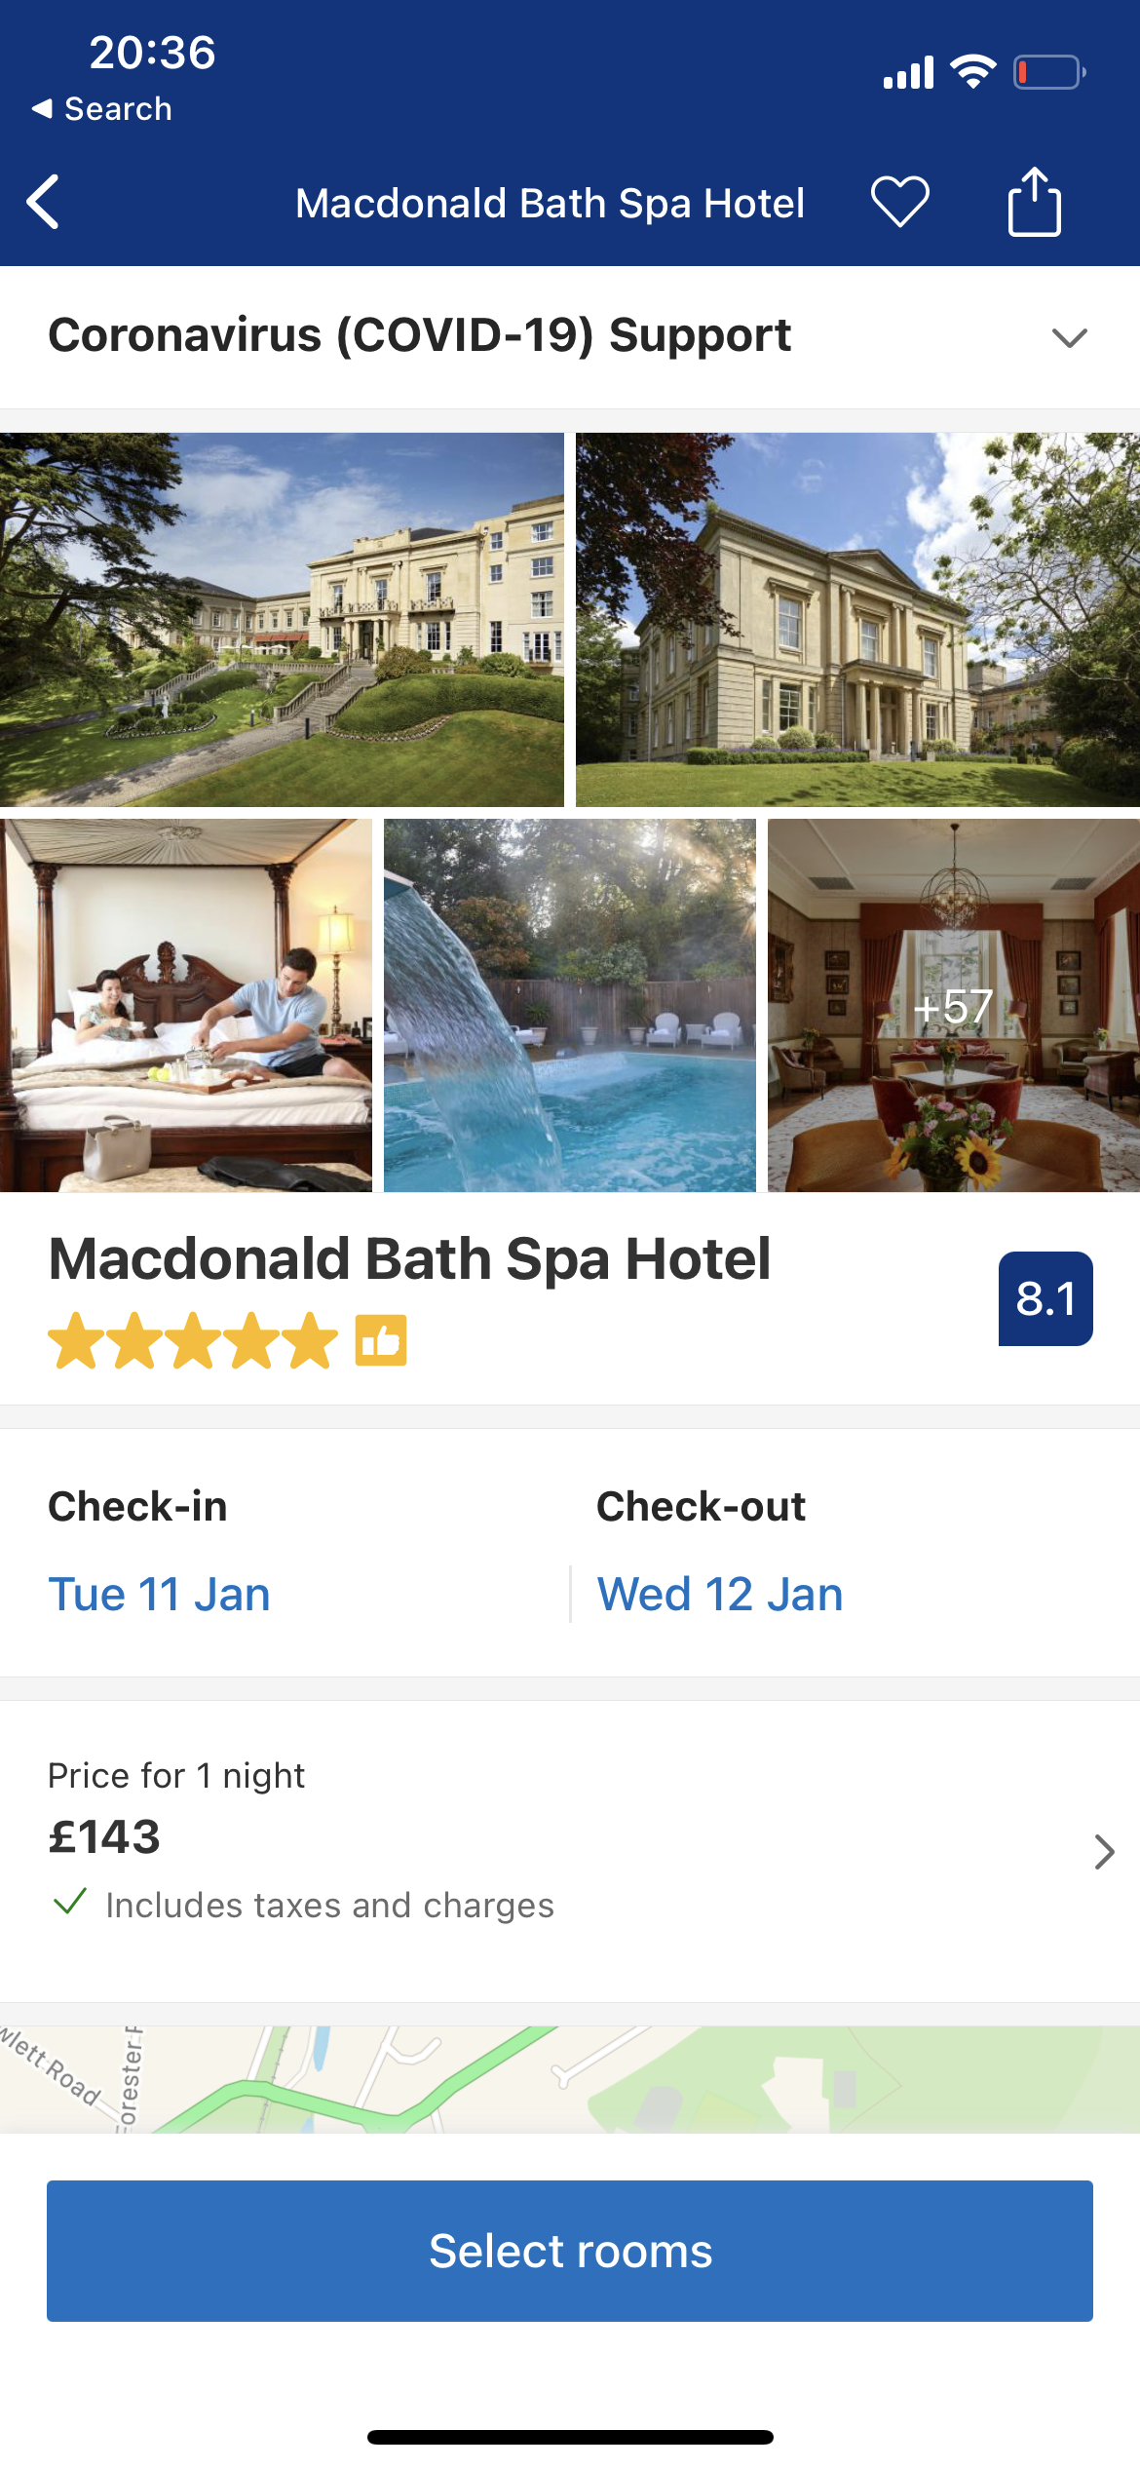
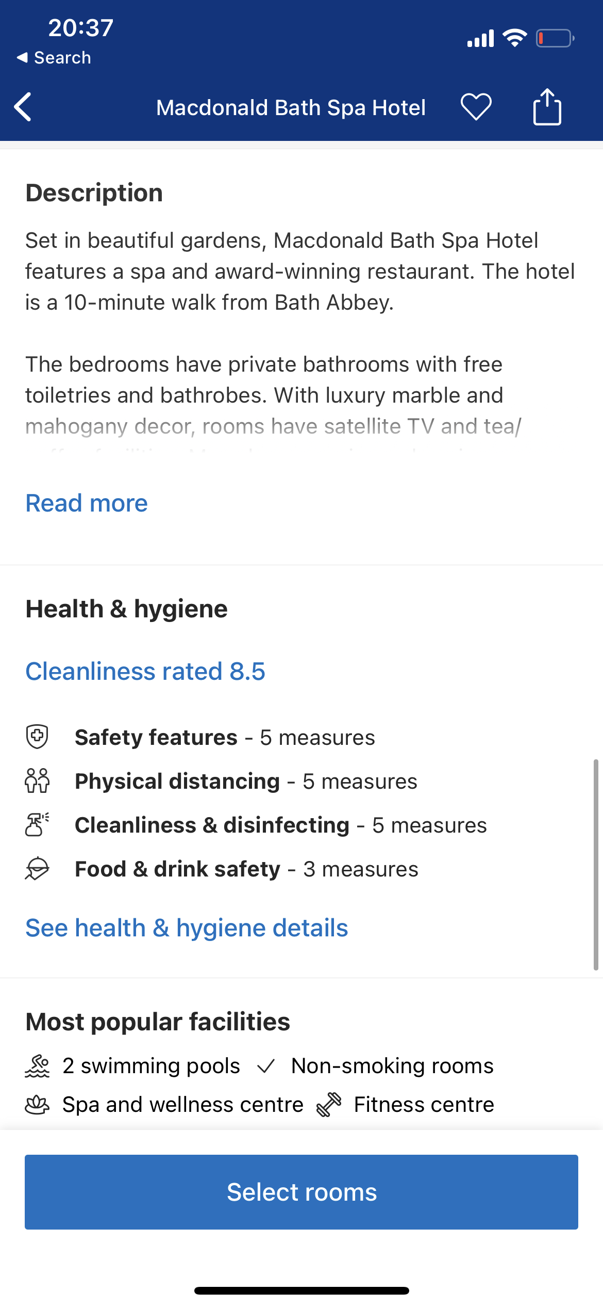
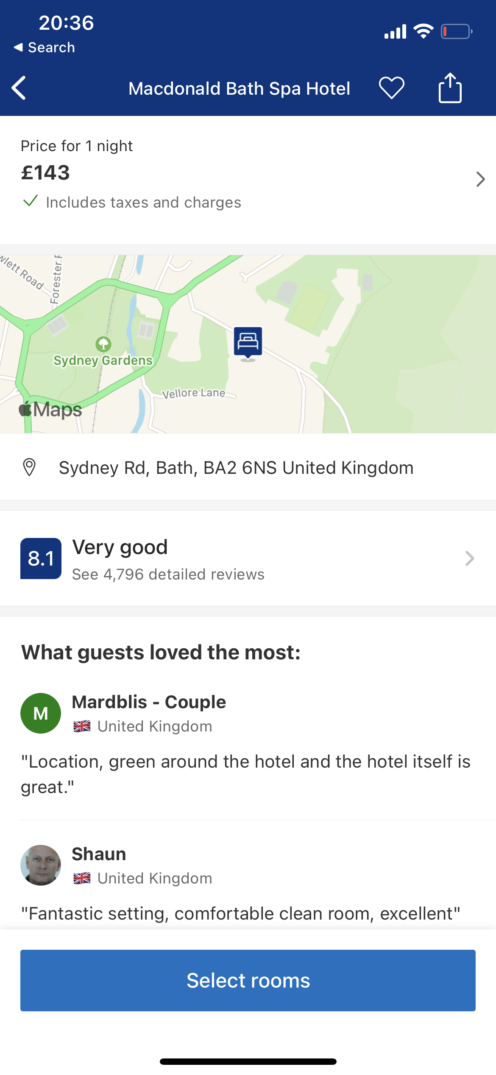
Mobile Version
Please replace the blue by the ETIC green

Slide 6
Next slide is showing a before and after

Slide 7
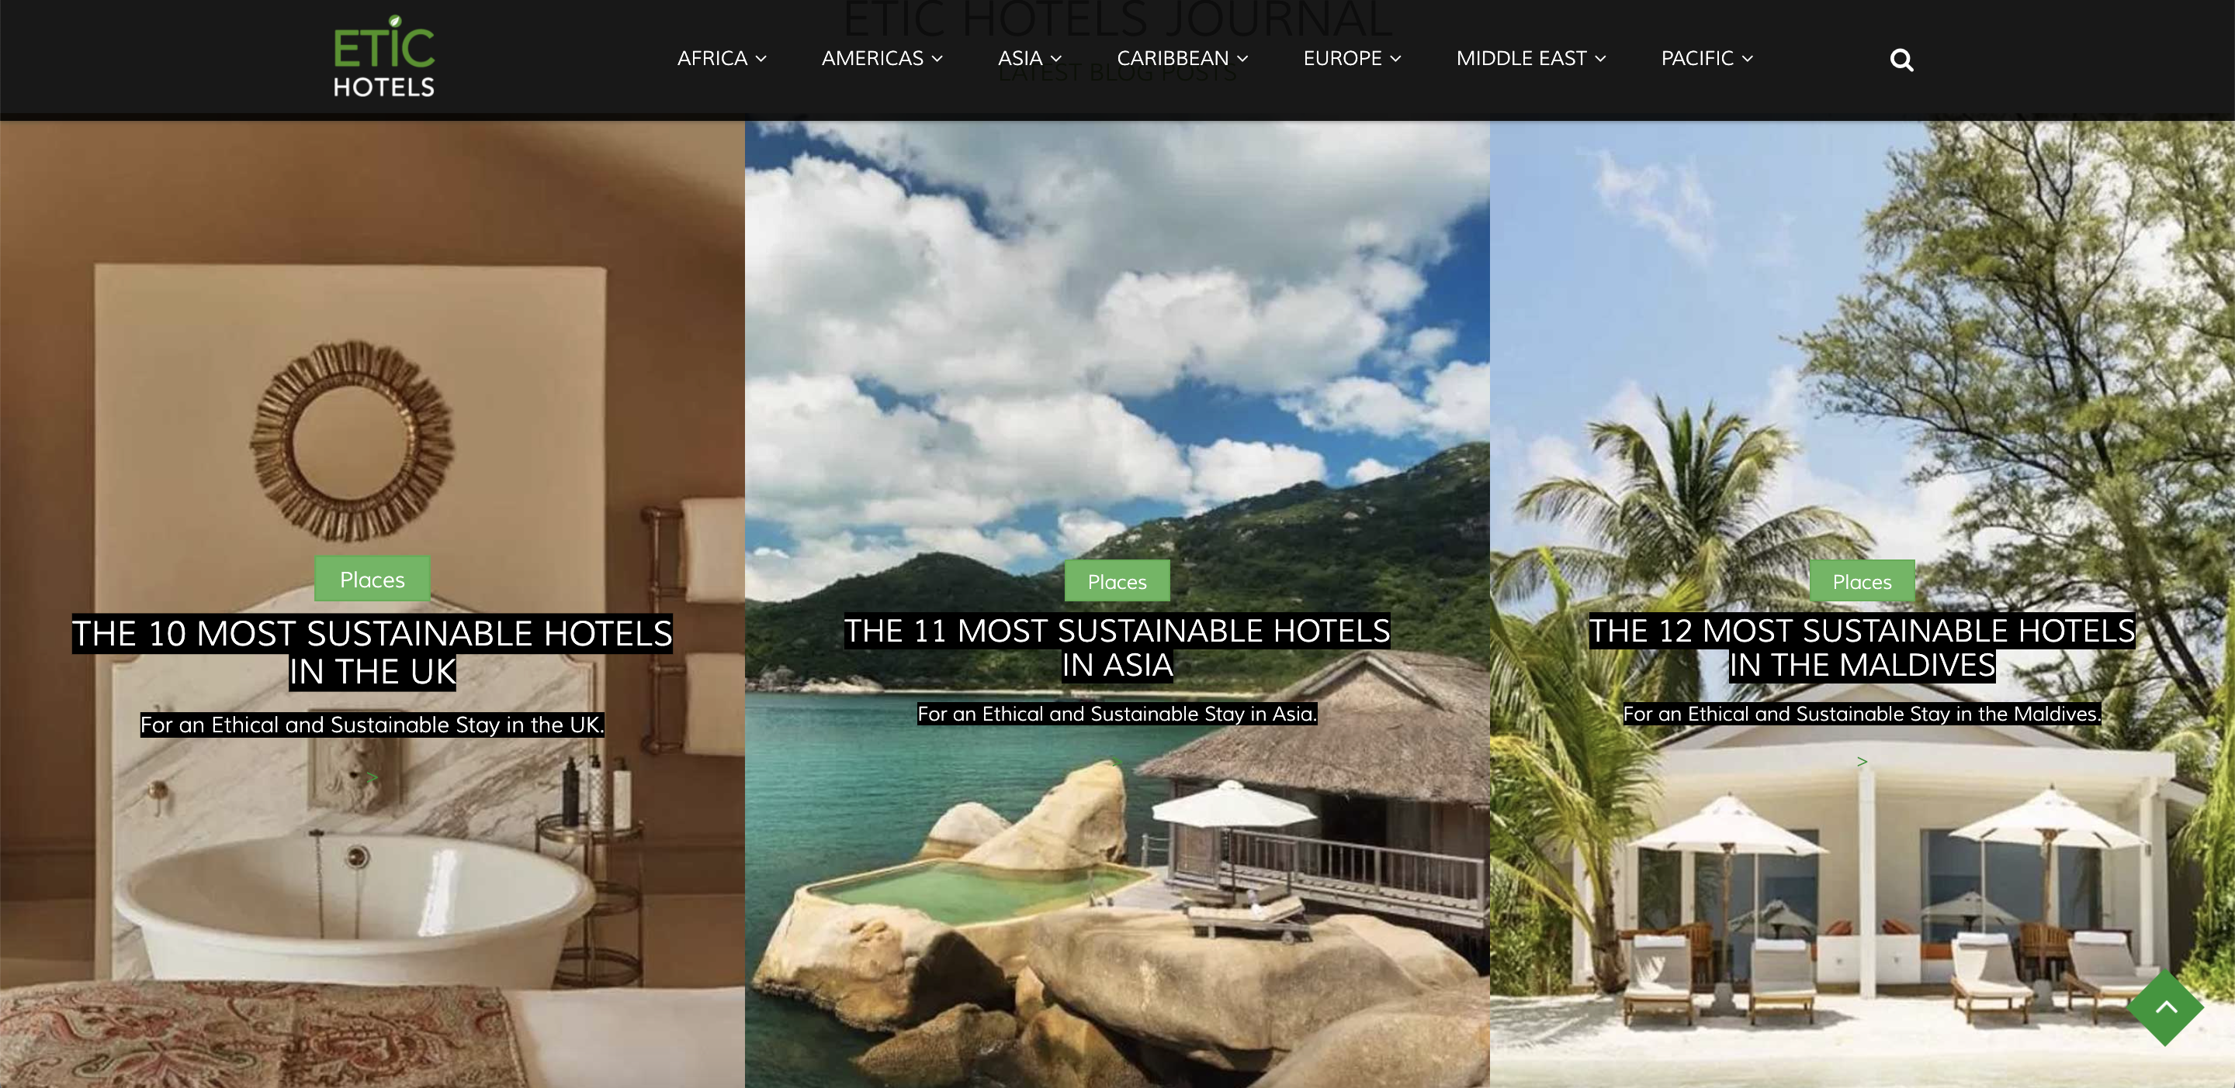
How it’s looking like now

Slide 8
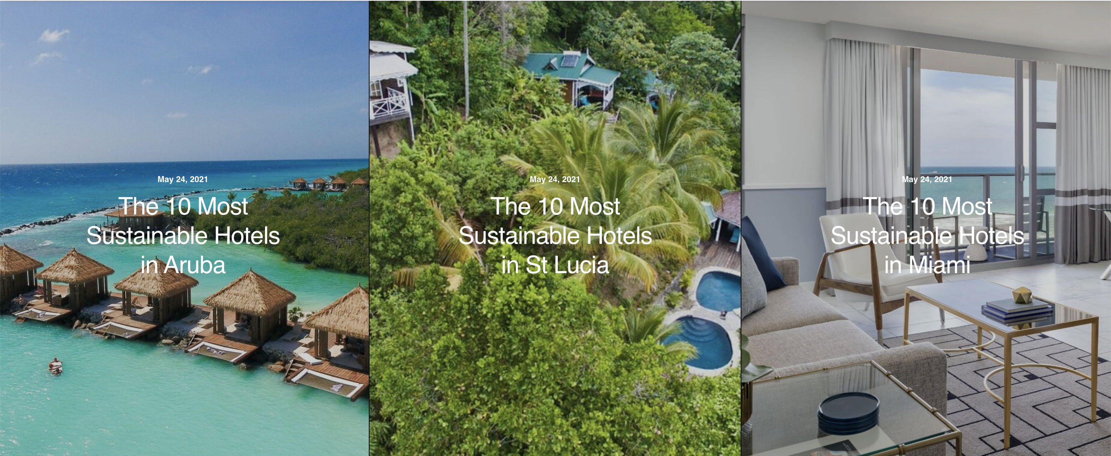
How it now needs to look (like on https://etichotels.com/journal/)

